Slide 1
Dynamic Analysis Techniques and Tools Dr Federica Paci
COMP6236 - Software Engineering and Cyber Security

Slide 2
Last Time
What static analysis is
scanning the source or binary code to find security vulnerabilities
How static analysis is performed
Create program intermediate representation
Abstract Syntax Trees, Control Flow Graphs
Analyze the intermediate representation with respect to security rules
Lexical analysis, Taint propagation, Control Flow Analysis

Slide 3
Today
Dynamic analysis tools and techniques
Hands-on exercises dynamic analysis of program executable

Slide 4
Learning outcomes
By the end of this session you will be able to
Define what a dynamic analysis tool is
Define several code instrumentation techniques
List dynamic analysis tools
Perform a simple dynamic analysis of a program executable

Slide 5
Dynamic Analysis
Approach for verifying software (including finding defects) by executing software on specific inputs & checking results
Functional testing, web application scanners, fuzz testing, etc.
Detection of vulnerabilities is integrated into the actual program’s execution

Slide 6
Code Instrumentation
A technique that inserts extra code into a program to observe its runtime behavior
The extra code is called instrumentation code
It inserts calls to analysis code when an instruction is executed
Analysis code collects data about the execution of an instruction or about its behavior
The code can be inserted in the source code or in the binary code

Slide 7
Instrumentation approaches
Source instrumentation
Instrument source programs
Binary instrumentation
Instrument executables directly
Advantages for binary instrumentation
Language independent
No need to recompile the code
All code is naturally covered

Slide 8
Code Instrumentation: Source Code
#include <stdio.h>
int addnum(int a, int b)
{
int sum;
sum= a+b;
return sum;
}
int main()
{
int total;
int x,y;
x = 4;
y = 7;
total = addnum(x,y);
printf("total %d\n”, total);
}

Slide 9
Code Instrumentation: Source Code
include <stdio.h>
int addnum(int a, int b)
{
int sum;
printf("Debug: Entering addnum %s %d\n",
__FILE__, __LINE__);
sum = a+b;
printf("Debug: Leaving addnum %s %d\n”,
__FILE__, __LINE__);
return sum;
}

Slide 10
Code Instrumentation: Source Code
include <stdio.h>
int addnum(int a, int b)
{
int sum;
#ifdef INSTDEBUG
printf("Debug: Entering addnum %s %d\n”,__FILE__, __LINE__);
printf("Debug: a = %d\n”, a);
printf("Debug: b = %d\n”, b);
#endif
sum = a+b;
#ifdef INSTDEBUG
printf("Debug: sum = %d\n”, sum);
printf("Debug: Leaving addnum %s %d\n”,__FILE__, __LINE__);
#endif
return sum;
}

Slide 11
Compile-time Instrumentation
Source
Code
Instrumentation
Code
(Library)
Compiler
Compile Time
Runtime
Instrumented
Executable Code

Slide 12
Compile-time instrumentation tools
gprof
provides program profiling
gcov
provides coverage analysis
dmalloc
provides drop in replacement for the system's malloc, realloc, calloc, free and other memory management routines to enable runtime tracking of memory-leaks, out-of-bounds writes, and other capabilities

Slide 13
Runtime-Instrumentation
Instrumentation
Code
Virtual Machine
Binary Code
Code
Cache
JIT Compiler
Dispatcher

Slide 14

Valgrind
It is a tool suite that provides a number of debugging and profiling tools
The most popular of these tools is called Memcheck
detects many memory-related errors that are common in C and C++ programs and that can lead to crashes and unpredictable behaviour

Slide 15
Installing Valgrind
Download Valgrind from http://valgrind.org/downloads/
“cd” to the directory containing the package’s source code
Type “./configure”
Type “make” to compile the package
Type “make install” to install the program

Slide 16
Run Valgrind
Prepare the program
Compile the program with the -g debug option
e.g gcc -g –O0 sourcefile.c -o binarycodename
Run valgrind
Type valgrind –leak-check=yes ./binarycodename arg1 arg2..argn

Slide 17
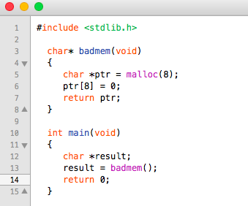
Valgrind

Slide 18
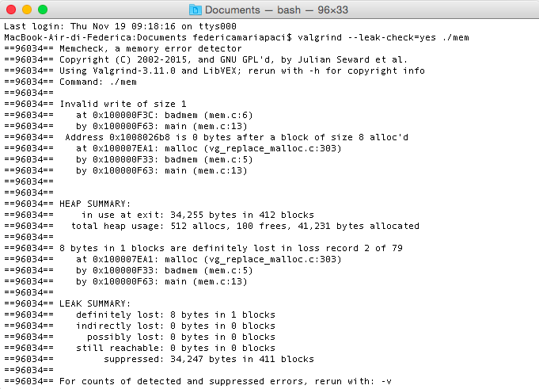
Valgrind

Slide 19
Exercise
Use Valgrind to analyze the following code:
#include <stdio.h>
#include <string.h>
void copyData(char *userId) {
char smallBuffer[10];
strcpy(smallBuffer, userId);
}
int main(int argc, char *argv[]) {
char *userId;
gets(userId);
copyData (userId);
}

Slide 20

Pin
Pin is a dynamic binary instrumentation framework developed by Intel Corp
It lets you build program analysis tools called Pintools for Windows and Linux platforms
Pintools are written in C/C++
You can use these Pintools to monitor and record the behavior of a program while it’s running

Slide 21
An Example of Pintool

Slide 22
Pro
No false positives
An error detection occurs right at the moment of its occurrence
Do not need source code
You can test also proprietary code

Slide 23
Cons
Detect vulnerabilities only on execution path defined by the concrete input data
Significant computational resources are required to perform the analysis
One execution path can be checked at each particular moment
It is more difficult to track back a vulnerability to its exact location in the code

Slide 24
Other types of dynamic tools
Network scanners
Network sniffers
Network vulnerability scanners
Web application scanners
Intrusion detection systems
Firewalls
Debuggers

Slide 25
The three most important things
Write down the three most important things about this lecture
Those three things that capture the essence of this lecture for you
Time: 2 minutes
Notes:
Scrivere cosa devono fare

Slide 26
Reading Materials
N. Nethercote. Dynamic binary analysis and instrumentation. University of Cambridge technical report N° 606.
Tools
http://valgrind.org/
http://www.pintool.org/
Pin 2.10 User Guide http://www.pintool.org/docs/45467/Pin/html/
http://www.dyninst.org/

Slide 27



What’s a PhD?
What’s a PhD in ECS like?
FIND OUT NOVEMBER 25
at
Meet Current PhDs and Supervisors
Hear and try out ECS research, live
Tour behind the scenes in international leading labs
Sign up at
http://www.southampton.ac.uk/about/visit/postgraduate-open-day.page

Slide 28


ECS Schedule in detail will be here:
http://www.ecs.soton.ac.uk/phd/open-afternoon

